Slide 1
Machine Learning Foundations – Session 4 of 8 Part Series on Deep Learning with Python
Nethra Sambamoorthi, Ph.D
Institute of Analytics USA ™
NOV 17, 2020

Slide 2
What is an algorithm?
In mathematics and computer science, an algorithm is,
a finite sequence of computational steps, typically to solve a class of problems or to perform a computation.
A winning algorithm reduces the number of steps, reduces the space required to store intermediate results, and reduces the computation time

Slide 3
Examples…
Ordering a collection of N numbers using only N+1 memory registers
Nearest neighbor clustering using k-means
Page rank
Statistical algorithms
When we make statistical algorithms machine learnable, we call it machine learning algorithms – because the volume of data are huge or because data are machine readable

Slide 4
Learning Algorithms It is all about what is emerging from randomness. The patterns are of different types
Classification – Conditional separation and grouping
Regression – Conditional Averaging and de-averaging
Association – correlation and independence
Ordering - Sequencing and randomness
Clustering – Grouping and Segmenting
Connectedness – Networking and repelling
The alternative hypotheses is that there is some pattern.

Slide 5
We are likely to see more non-randomness, if our comparison bag does not include randomness
Some well-defined most popular ones are
Regression
Classification
Some yet to get defined well, groups of learning are
Ordering
Clustering
Association
Sequencing
Connectedness

Slide 6
A learning method is well defined, if
Structure is well defined – variables, relationships among atomic variables, and among errors and between atomic variables and errors
Population and samples are well defined – units and sampling design
Randomness is well defined – For totality of the sum of structure and randomness is the full bag from which samples are selected
Learning is well defined – is learning ranking, grouping, and averaging, sequencing, associating, and networking?
Sequential updating of learning is well defined – how to degrade or upgrade the weights?
Stopping rule is well defined – when do we stop before confirming the structure

Slide 7
In the world of uncertain data… algorithm development means the following
Data Structure, Data Types, and Data Formats (STF) defines an algorithm (Images are RGB data structure, comes in a range of integer values between 0 and 255 each plane)
Feature engineering brings the variations due to STF, to more commonly understood or resolvable computational quantities (standardized data to 255 is what matters, and another feature is suppress all colors colors and use only gray scale – use grey scale values only)
However, once the STF and Feature Engineering are brought to the computational standards, then it is a matter of following, again standardized way of creating structure vs. randomness resolution.
That is build one of the models – regression, classification, association, ordering, clustering, and connecteness

Slide 8
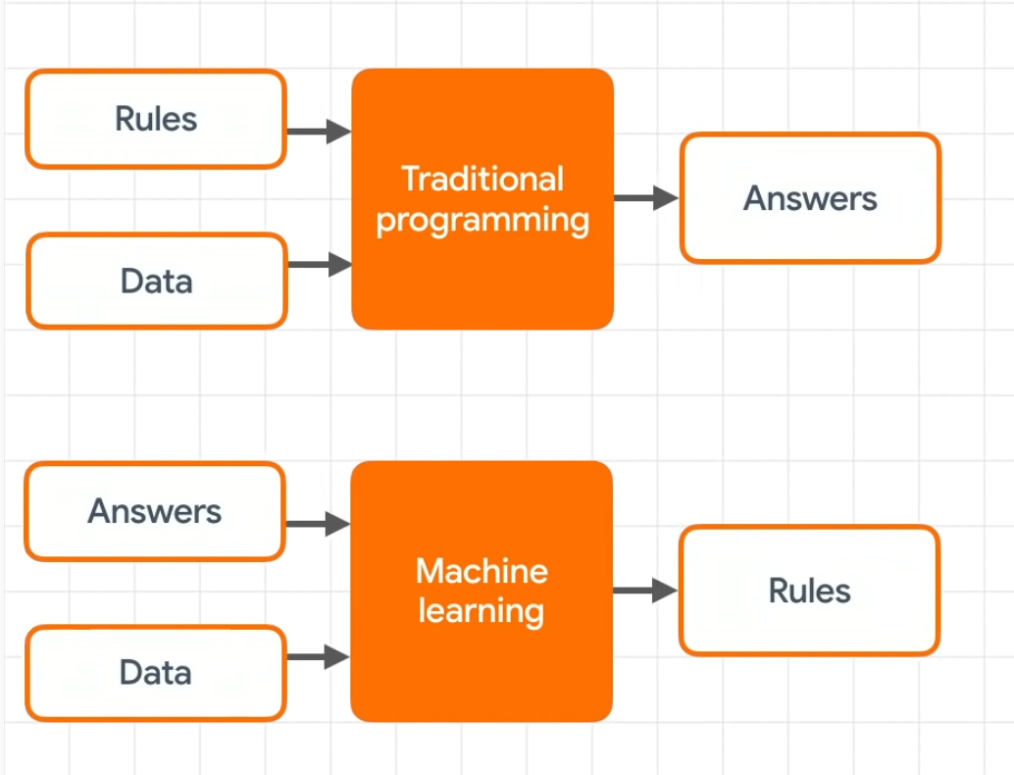
What is Machine Learning ?
Supervised algorithms
https://youtu.be/_Z9TRANg4c0?list=PLOU2XLYxmsII9mzQ-Xxug4l2o04JBrkLV&t=132

Slide 9

What is Machine Learning ?
Un-supervised algorithms
https://youtu.be/_Z9TRANg4c0?list=PLOU2XLYxmsII9mzQ-Xxug4l2o04JBrkLV&t=132

Slide 10
Predicting Traffic Jam

Slide 11
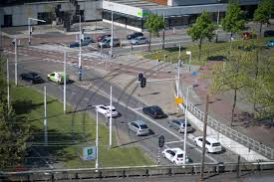

Slide 12
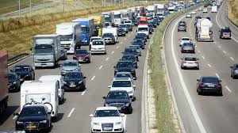

Slide 13
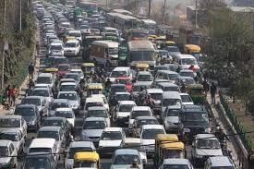

Slide 14
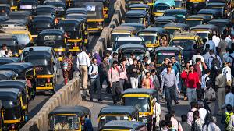

Slide 15
Predicting Traffic Jam
People left the cars (probably not everybody, but those who have drivers and walking to a near by train station possibly or those whose destinations are near by
Left traffic is jam ~5 MPH; right is moving normally; 55 mph
Traffic 0 mph; stuck; cars not moving
No traffic jam
If (rate of change of distance(rdis) calculated from (LAT_LONG) previously sample place to current place (LAT_LONG) changes in the last 10 seconds results in >55 and mph in a 55 mile zone (recent knowledge), tJam=FALSE, elseif { rdis 40, zone =55) traffic =ORANGE, elseif { rdis=1-20, zone=55} traffic=red, elseif {rdis=0, zone=55} Expressway=ParkingLOT
Continuously updating algorithm around the world, as long as they have prior knowledge of the road speed, which itself is a knowledge Google could have gained, by simply studying the long-term trend in knowledge of data

Slide 16
Four Essential Principles for Developing ML algorithms
Every ML algorithm requires
Feature engineering to make algorithm easily achieve its goals in reduce the loss in prediction
Train/Validate/Test
Use principles of Bias-variance trade off to figure out the model, using training/validate/test sample split ideas as well as CROSS-Validation methods
Use principles of parsimony of parameters via penalized loss functions such as L1 and L2 penalty methods

Slide 17
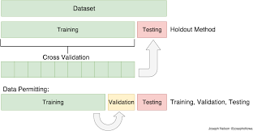
Feature Engineering
towardsdatascience.com

Slide 18
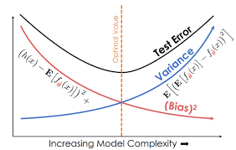
Bias Variance Trade off along with Cross-Validation is the Gold Standard for Identifying the Best Model for a Given Dataset
The bias error is an error from erroneous assumptions in the learning algorithm. High bias can cause an algorithm to miss the relevant relations between features and target outputs (underfitting).
The variance is an error from sensitivity to small fluctuations in the training set. High variance can cause an algorithm to model the random noise in the training data, rather than the intended outputs (overfitting).
wikipedia.org
Optimal range of complexity
http://rasbt.github.io/mlxtend/user_guide/evaluate/bias_variance_decomp/ - computations bias vs. variance for a given data set
ds100.org

Slide 19
Train, Validate, Test

Slide 20
One More Tool in Machine Learning Methods: Use principles of parsimony of parameters via penalized loss functions such as L1 and L2 penalty methods

Slide 21
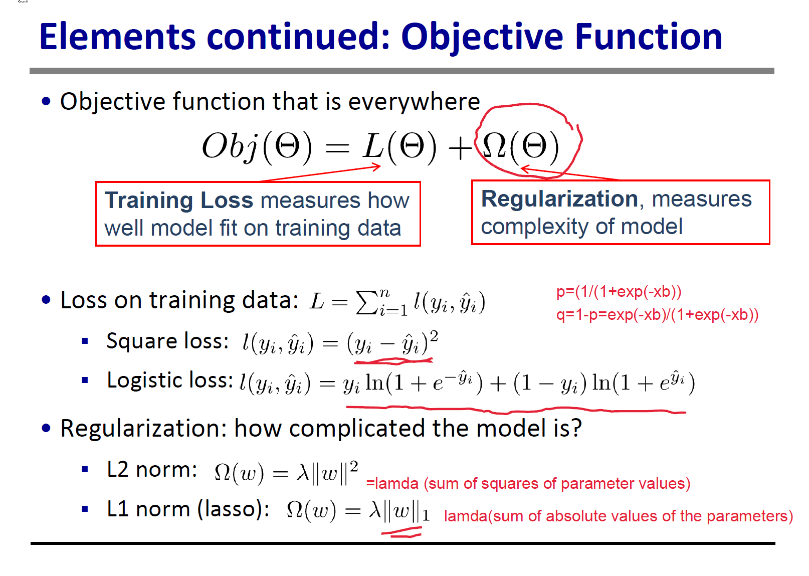
Loss function for regression type problems

Slide 22
